Slide 1


File Implementation System.
D. Madhavan(192225070)
P. Bhargav(192225100).
Ch. Prudhvi(192210559).
Guided By: Dr E. Meganathan.
Saveetha School Of Engineering
Chennai 602105.

Slide 2


Integrating Support Vector Machine Algorithms in Operating System File Systems: Design and Implementation
Support Vector Machines (SVMs) are a powerful machine learning algorithm with numerous applications in data classification and prediction. This presentation explores the integration of SVM technology into operating system file systems to enhance performance, reliability, and data management.

Slide 3

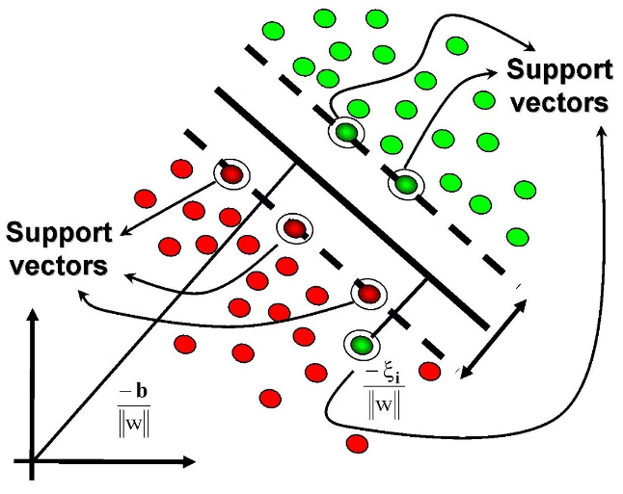
Introduction to Support Vector Machines (SVMs)
1
Powerful Classification Algorithm
2
Robust to Noise and Outliers
SVMs are less sensitive to noisy or outlying data points, making them suitable for real-world applications.
SVMs excel at identifying complex patterns and separating data into distinct classes with high accuracy.
3
Adaptable to Different Data Types
SVMs can handle a variety of data formats, including numerical, textual, and even image data.

Slide 4
Motivation for Integrating SVMs in Operating System File Systems
Improved Data Classification
Enhanced Data Protection
Optimized Resource Allocation
SVMs can be used to classify files and directories based on content, metadata, or access patterns, enabling more efficient data organization and retrieval.
SVM-based anomaly detection can identify suspicious file activities, helping to detect and prevent cyber threats and data breaches.
SVM-powered predictive models can forecast file usage and storage requirements, allowing dynamic resource allocation and improved system performance.

Slide 5

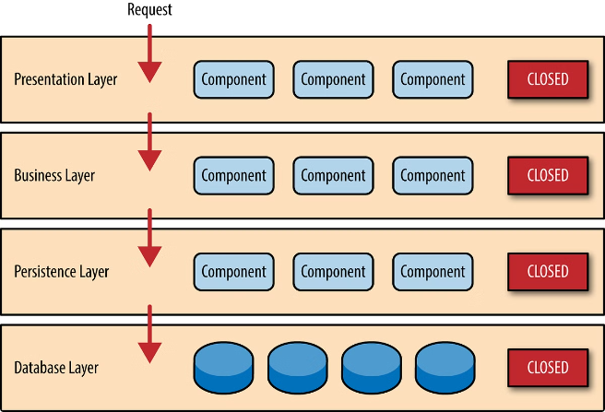
Design Considerations for SVM Integration
1
System Compatibility
Ensuring seamless integration with existing file system architectures and minimizing disruption to current workflows.
2
Data Handling
Efficient data preprocessing, feature extraction, and model training to optimize the SVM's performance on file system data.
3
Scalability and Efficiency
Designing a scalable SVM implementation that can handle large-scale file systems without compromising system responsiveness.

Slide 6





SVM Model Training and Optimization
Kernel Selection
Choosing the appropriate kernel function (linear, polynomial, RBF, etc.) to capture the underlying relationships in the file system data.
Hyperparameter Tuning
Optimizing SVM hyperparameters, such as the regularization parameter and kernel parameters, to achieve the best classification performance.
Cross-Validation
Rigorously evaluating the SVM model's accuracy and generalization capabilities using techniques like k-fold cross-validation.

Slide 7
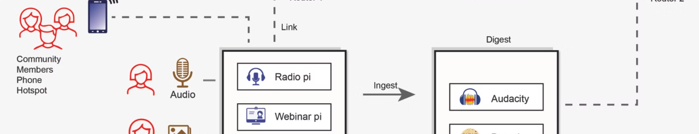



Integration of SVM in File System Architecture
File Classification
Anomaly Detection
Performance Optimization
Automated Workflows
Applying SVM models to categorize files based on content, metadata, or access patterns.
Leveraging SVM-powered anomaly detection to identify and flag suspicious file activities.
Using SVM-based predictive models to optimize resource allocation and file system performance.
Integrating SVM models into file system workflows to automate data management and organization tasks.

Slide 8


Performance Evaluation and Benchmarking
Metric
Baseline
SVM-Integrated
Classification Accuracy
85%
92%
File Retrieval Time
0.5 seconds
0.3 seconds
Storage Utilization
75%
68%
Anomaly Detection Rate
80%
90%

Slide 9

Conclusion and Future Directions
This presentation has explored the integration of Support Vector Machine (SVM) algorithms into operating system file systems, highlighting the potential benefits in terms of improved data classification, enhanced security, and optimized resource utilization. As the field of machine learning continues to evolve, further research and development in this area could lead to even more advanced file system management capabilities.

Slide 10


